Slide 1
INDEPENDENT PORTFOLIO CASE STUDY
Commercial Brokerage Revenue Forecasting & Pricing Model
Independent Portfolio Case Study | Hypothetical Commercial Real Estate Brokerage Platform
Built a driver-based operating model to assess the growth, profitability, and downside resilience of a producer-led commercial brokerage platform.
TOTAL GCI
EBITDA
EBITDA MARGIN
PRODUCER EPE
$262.3M
$37.8M
14.4%
167.7
2026E
→
$357.6M
2030E
2026E
→
$57.2M
2030E
2026E
→
16.0%
2030E
2026E
→
211.3
2030E
KEY MODELING TAKEAWAY
Base Case Indicates Scalable Operating Economics with Positive Downside EBITDA
Independent portfolio case study · Hypothetical CRE brokerage platform · Figures illustrative
01
Notes:
Independent, hypothetical portfolio case study. Driver-based operating model for a producer-led commercial brokerage platform. Base Case: GCI grows $262M to $358M, EBITDA $38M to $57M, margin 14.4% to 16.0%. Scalable economics with positive downside EBITDA.

Slide 2
MODEL ARCHITECTURE
How the Model Works
DRIVER CHAIN
MODEL STRUCTURE
Transaction Volume
Average Deal Size
Inputs
→
Operating Engines
→
P&L
→
Scenarios
→
Dashboard & Checks
Commission Rates
Headcount · Ramp · Attrition
↓
11
4
Gross Commission Income
Linked model tabs
Revenue Streams
↓
Producer Payouts
3
89
↓
Scenarios
Integrity checks
Company Dollar
↓
FOUR BUSINESS LINES
Operating Expenses
Leasing
Investment Sales
↓
Debt & Equity Placement
EBITDA & After-Tax Operating Income (Unlevered)
Valuation & Advisory
Independent portfolio case study · Hypothetical CRE brokerage platform · Figures illustrative
02
Notes:
The model is driver-based: transaction volume, deal size, commission rates and producer headcount build GCI, which flows through producer payouts to Company Dollar, then operating expenses to EBITDA and after-tax operating income. Architecture: 11 linked tabs, four business lines, three scenarios, 89 integrity checks.

Slide 3
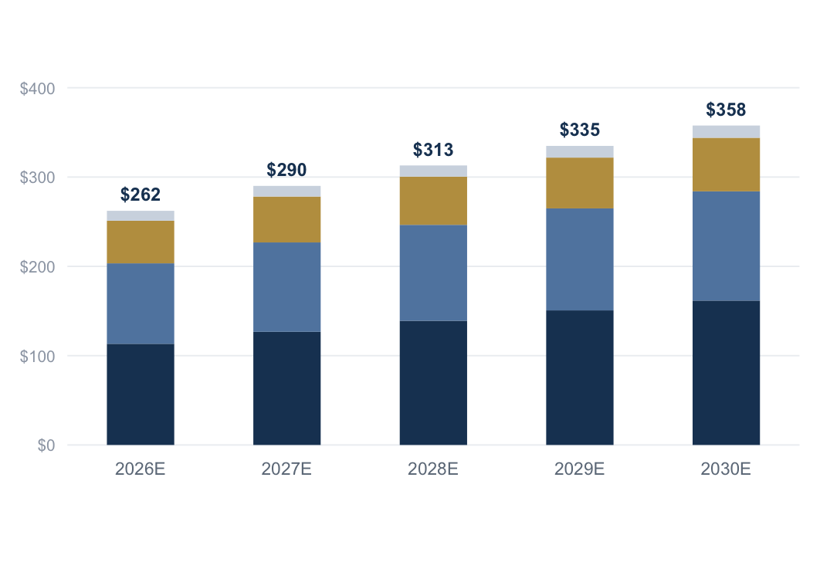
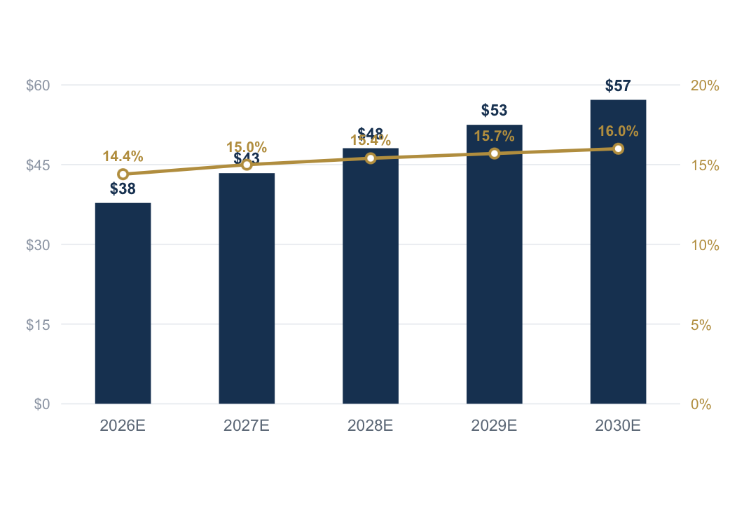
ILLUSTRATIVE OPERATING OUTLOOK
Forecast Growth Is Driven by Operating Capacity and Transaction Activity
Revenue Mix by Business Line
EBITDA Growth & Margin Expansion
2026E–2030E · Gross Commission Income, $M
2026E–2030E · EBITDA $M (bars) · EBITDA Margin % (line)
Leasing
Investment Sales
Debt & Equity
Advisory
EBITDA ($M)
EBITDA Margin (%)
GCI grows from approximately $262M to $358M, while EBITDA expands from approximately $38M to $57M as fixed-cost leverage improves profitability.
Margin expansion framed 2026E–2030E. Revised referral-fee treatment limits 2025A→2026E comparability.
03
Notes:
Two exhibits. Left: revenue mix by business line, 2026E to 2030E in dollars. Right: EBITDA growth with margin expansion on a secondary axis. GCI grows from about $262M to $358M while EBITDA expands from about $38M to $57M as fixed-cost leverage improves profitability. Margin framed 2026E to 2030E only.

Slide 4
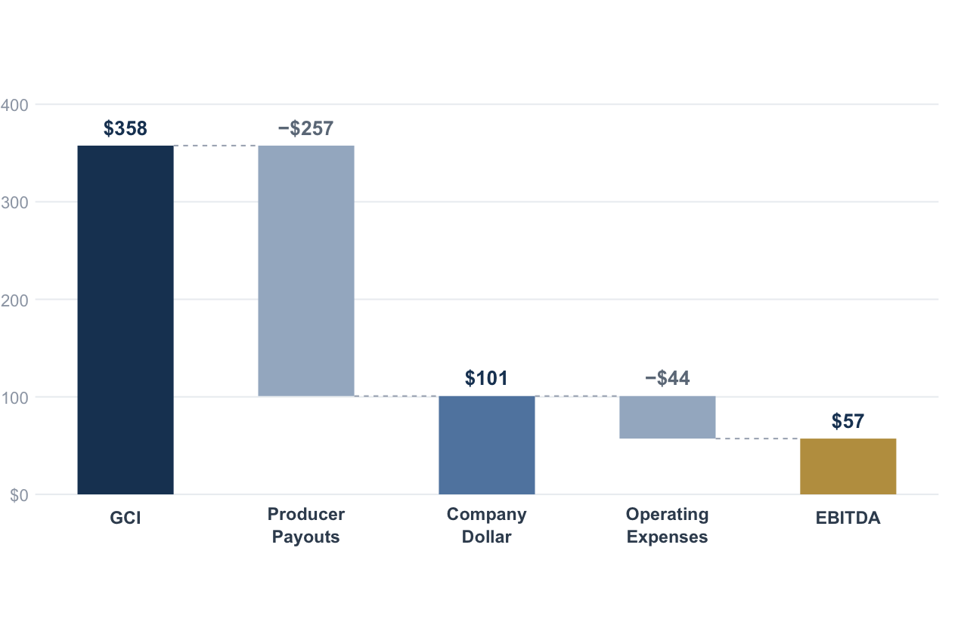
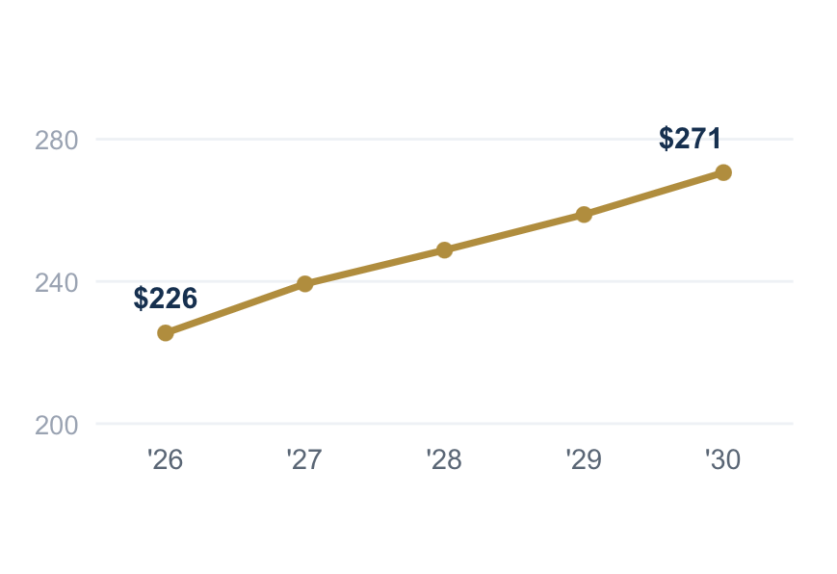
PRODUCER & UNIT ECONOMICS
Company Dollar Connects Producer Economics to Profitability
GCI → Company Dollar → EBITDA Waterfall
PRODUCER EPE
REVENUE / EPE
EBITDA / EPE
2030E Base Case · $M
211.3
$1,692K
$270.6K
COMPANY DOLLAR
CO$ MARGIN
EFF. PAYOUT
$100.8M
28.2%
71.8%
EBITDA per EPE Trend
2026E–2030E · $K per effective producer
Company Dollar remains relatively stable as a share of GCI, while EBITDA margin expands below Company Dollar as fixed corporate costs are spread across a larger producer base.
Independent portfolio case study · Hypothetical CRE brokerage platform · Figures illustrative
04
Notes:
Company Dollar connects producer economics to profitability. The waterfall shows 2030E Base Case: GCI $357.6M less producer payouts $256.8M equals Company Dollar $100.8M, less operating expenses $43.6M equals EBITDA $57.2M. Company Dollar stays stable as a share of GCI near 28%, while EBITDA margin expands below it as fixed corporate costs spread across a larger producer base.

Slide 5
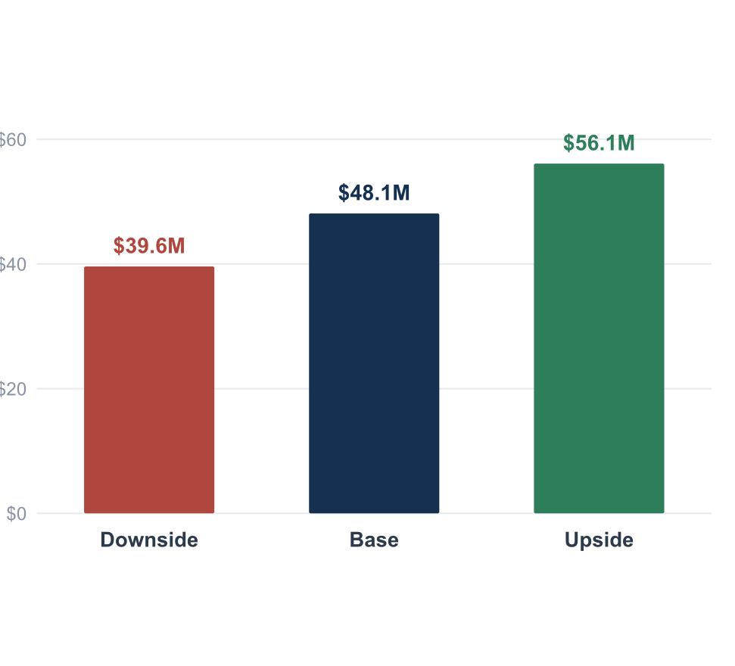
DOWNSIDE RESILIENCE
Scenario Analysis Tests Downside Resilience
RISKS & MITIGANTS
EBITDA by Scenario
2028E Representative (Scenario Comparison) · $M
RISK
MITIGANT
Producer attrition
Variable payout structure
Transaction-market cyclicality
Diversified business-line mix
Fee compression
Company Dollar focus
Hiring & ramp execution
Disciplined hiring assumptions
Scenario estimates are derived from the integrated scenario framework; see model methodology for detailed assumptions.
Illustrative operating case · Scenario outputs from the integrated 2028E framework (Tab 09)
05
Notes:
Scenario analysis tests downside resilience using the integrated 2028E scenario-comparison framework. EBITDA by scenario: Downside $39.6M, Base $48.1M, Upside $56.1M. Even the downside stays solidly positive. Key risks - producer attrition, market cyclicality, fee compression, hiring execution - are mitigated by variable payout structure, a diversified business-line mix, Company Dollar focus, and disciplined hiring assumptions.

Slide 6
KEY MODELING TAKEAWAYS
What This Model Demonstrates
01
02
03
Revenue is built from operating drivers rather than a top-down growth assumption.
Producer payouts and Company Dollar determine the platform's true operating economics.
Fixed-cost leverage supports margin expansion while variable compensation protects downside profitability.
SKILLS DEMONSTRATED
Driver-Based Forecasting
Operating Model Design
Scenario Planning
Producer & Commission Economics
Executive Reporting
Model Integrity Controls
Commercial brokerage profitability is shaped by transaction activity, producer productivity, compensation economics, and operating leverage—not revenue growth alone.
Independent portfolio case study. Forecasts are illustrative. After-Tax Operating Income is unlevered and assumes a 26.0% illustrative effective tax rate; no financing schedule is modeled. · 06
Notes:
What this model demonstrates: revenue built from operating drivers not a top-down assumption; producer payouts and Company Dollar determine true operating economics; fixed-cost leverage supports margin expansion while variable comp protects downside. Skills: driver-based forecasting, operating model design, scenario planning, producer and commission economics, executive reporting, model integrity controls. Conclusion: brokerage profitability is shaped by transaction activity, producer productivity, compensation economics and operating leverage - not revenue growth alone.

